Slide 1


<Sandeep P Vangala>
<01/14/2023>

Slide 2

Outline
Executive Summary
Introduction
Methodology
Results
Conclusion
Appendix

Slide 3
Executive Summary
Summary of methodologies
Data collection via different proceedings (API-Interface, Web Scraping, API Scraping)
Data wrangling
Exploratory data analyzing with SQL and visualization
Interactive visual analytics with Folium and Dashboard
Predictive Analysis for different classification model by using machine learning
Summary of all results
Exploratory data analysis for the results of the different classification models
Interactive analytics demo in screenshots
Results of Predictive analysis

Slide 4
Introduction
Project background and context
When compared to other suppliers, Space X offers their Falcon 9 rocket launches at a low cost of $62 million. Other vendors charge launch fees of more than $165 million. The first stage's reuse is what accounts for the significant cost difference. The ability to forecast whether or not a rocket's first stage can land again and be reused is therefore of significant importance to companies other than Space X. Therefore, the stated objective of this project is to build a machine learning pipeline with various classifiers in order to be able to forecast whether the first stage will successfully land.
Problems you want to find answers
Are there specific elements that affect the likelihood of a successful first stage landing? Is there a relationship between the several elements that make up a successful land maneuver?

Slide 5

Section 1

Slide 6
Methodology
Executive Summary
Data collection methodology:
Data were collected by using SpaceX-API und web scraping from Wikipedia page
Perform data wrangling
Data were cleaned from irrelevant information and creating one-hot-encoding data fields for machine learning
Perform exploratory data analysis (EDA) using visualization and SQL
Data were visualized by different kinds of plots for searching the pattern.
Perform interactive visual analytics using Folium and Plotly Dash
Perform predictive analysis using classification models
How to build, tune, evaluate classification models

Slide 7
Data Collection
Describe how data sets were collected.
Requesting the SpaceX-API
Decoding the response content, coming in json-format, and turn into a Pandas dataframe
Cleaning dataframe from uninteresting columns and multiple rows
Filter according to desired parameters
Checking the dataset for missing data and filling missing data up where required
You need to present your data collection process use key phrases and flowcharts
Transforming the received html-table into a Pandas DataFrame

Slide 8
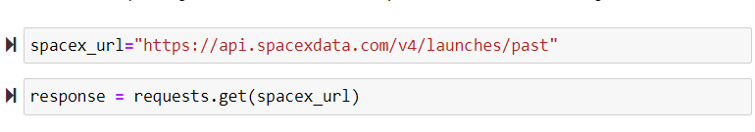
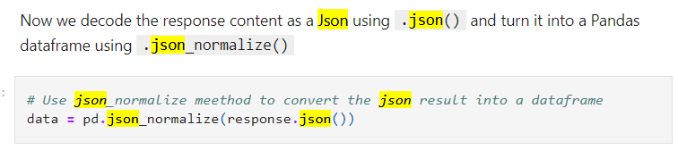
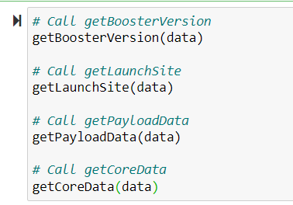
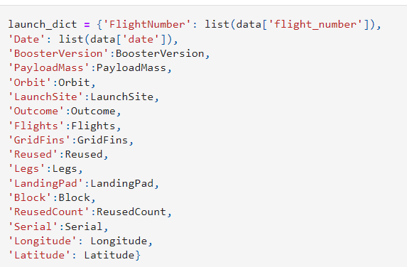
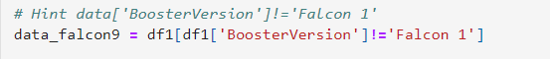
Data Collection – SpaceX API
1
Present your data collection with SpaceX REST calls using key phrases and flowcharts
Getting response from SpaceX-API
Converting response to json-file and transferring into a Data-Frame
Clean up the data using prepared functions
Creating a final dataset with the columns of interest
Filtering dataset for selected Booster Version
GitHub URL: https://github.com/vangalasandeep/IBMCapstone/blob/master/Data%20Collection%20API%20Lab.ipynb
2
3
4
5

Slide 9
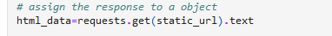
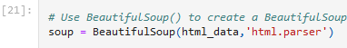
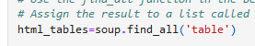
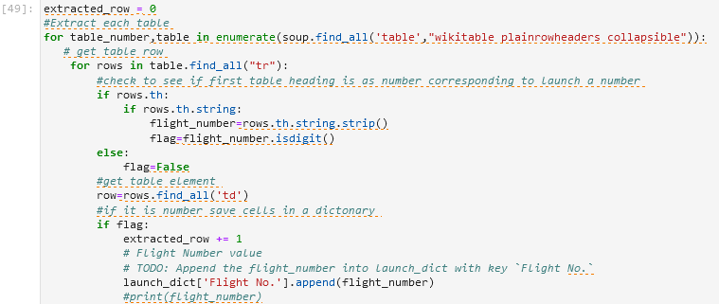
Data Collection - Scraping
Present your web scraping process using key phrases and flowcharts
Requesting Falcon9 Launchdata from Wiki-page
Creating Beautiful-soup object from HTML response
Extract all column/variable names from the HTML table header
Create a data frame by parsing the launch HTML tables
Exporting data to CSV-file
https://github.com/vangalasandeep/IBMCapstone/blob/master/jupyter-labs-webscraping.ipynb
1.
2.
3.
4.
5.
9

Slide 10
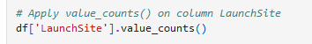
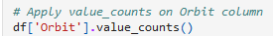
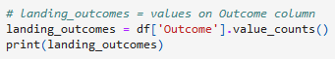
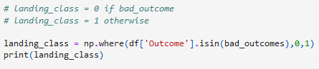
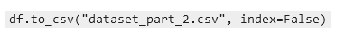
Data Wrangling
Exploratory Data Analysis and Determine Training Labels
https://github.com/vangalasandeep/IBMCapstone/blob/master/labs-jupyter-spacex-Data%20wrangling.ipynb
Calculate the number of launches on each site
Calculate the number and occurrence of each orbit
Calculate the number and occurence of mission outcome per orbit type
Create a landing outcome label from Outcome column
Exporting data to CSV-file

Slide 11
EDA with Data Visualization
Different chart types and dependencies were plotted
Payload-Mass vs. Flight Number / Launch site vs. Flight Number / Launch site vs. Payload-Mass
orbit vs. success rate / Flight number vs. orbit / Payload Mass vs. orbit
Launch success yearly trend
The aim is to find patterns and dependencies in the plots, which can then be used to train the machine learning engine. The different chart types have different advantages for this.
scatterplots are useful to show relationships between variables
Bar charts are suitable for comparing the ratio of a variable in discrete classes with one another, if necessary, grouping them as well
Line plots show the progression of variables over time
GitHub URL: https://github.com/vangalasandeep/IBMCapstone/blob/master/jupyter-labs-eda-dataviz.ipynb

Slide 12
EDA with SQL
Display the names of the unique launch sites in the space mission
Display 5 records where launch sites begin with the string 'CCA'
Display the total payload mass carried by boosters launched by NASA (CRS)
Display average payload mass carried by booster version F9 v1.1
List the date when the first succesful landing outcome in ground pad was acheived
List the names of the boosters which have success in drone ship and have payload mass greater than 4000 but less than 6000
List the total number of successful and failure mission outcomes
List the names of the booster_versions which have carried the maximum payload mass. Use a subquery
List the records which will display the month names, failure landing_outcomes in drone ship ,booster versions, launch_site for the months in year 2015
Rank the count of successful landing_outcomes between the date 04-06-2010 and 20-03-2017 in descending order
GitHub URL: https://github.com/vangalasandeep/IBMCapstone/blob/master/jupyter-labs-eda-sql-coursera.ipynb

Slide 13
Build an Interactive Map with Folium
Objects mentioned in the interactive Map:
Every launch site is indicated on a map.
Latitude and longitude coordinates are used to mark NASA Johnson Space Center as a point on the map, and it is also given a text label.
Each X-space launch location is represented as a point, given a text label, and its latitude and longitude are shown on a map. Consequently, indicating the location and distance from the equator
The launch outcome for each start at each launch point is illustrated and color-coded.
Green markers indicate successful launches, while red markers indicate unsuccessful ones, providing a fast snapshot of the success percentage each launch site.
Measure the separations between a launch location and its environs.
Insertion of connecting lines from a chosen launch point (CCAFS SLC-40) to the coastline and close-by infrastructure like the closest railroad, road, or city. Establish the respective distances and enter them.
GitHub URL: https://github.com/vangalasandeep/IBMCapstone/blob/master/lab_jupyter_launch_site_location.ipynb

Slide 14
Build a Dashboard with Plotly Dash
List of all launch sites in a drop-down menu
Adding a dropdown menu to allow users to choose potential launch sites
Making a pie chart showing successful and unsuccessful launches (for all sites combined or for a single site)
A pie chart for all sites was included. Depending on choices, the overall number of successful launches against failed launches for the sites is aggregated or specific to a single site.
Include a payload range slider.
Add a Range Slider to Payload
Selection Payload mass vs. success rate is plotted in a scatterplot that is customizable for the various booster models.
Include a scatterplot to demonstrate the relationship between payload and launch success or failure rate.
GitHub URL: https://cf-courses-data.s3.us.cloud-object-storage.appdomain.cloud/IBM-DS0321EN-SkillsNetwork/labs/module_3/lab_theia_plotly_dash.md.html

Slide 15
Predictive Analysis (Classification)
Importing data to data frame and creating a NumPy array from column “class”
determine the model with the best predictive accuracy
contrast and compare the models by evaluating the jaccard_score and F1_score
Standardize data with StandardScaler and transform it
split dataset into train and test set with train_test_split
Examine the confusion matrix
Creating a object for the classification model
Calculating the accuracy on the test set by using „score“ method
Create a GridSearchCV object to find the best parameter and set parameters for the specific classification model
Applying GridSearchCV on the model
GitHUB URL: https://github.com/vangalasandeep/IBMCapstone/blob/master/SpaceX_Machine%20Learning%20Prediction_Part_5.ipynb

Slide 16
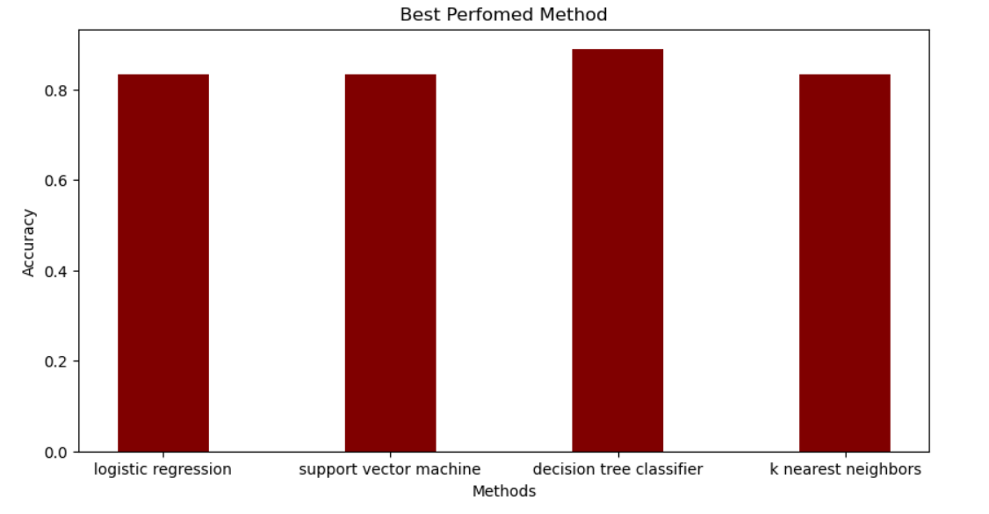
Results
Exploratory data analysis results
Interactive analytics demo in screenshots
Predictive analysis results

Slide 17

Section 2

Slide 18
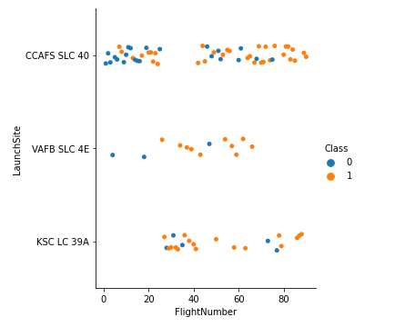
Flight Number vs. Launch Site
The CCAFS SLC 40 launch site hosted the initial launch attempts.
The chances of success grew as the initial attempts developed
VAFB SLC 4E and KSC LC 39A have the highest success rates for starting positions.

Slide 19
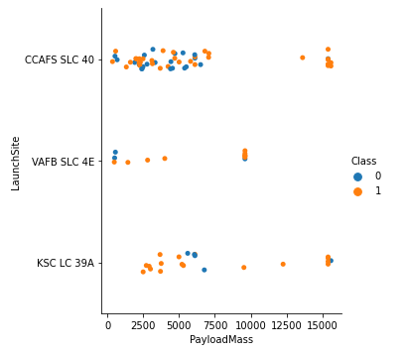
Payload vs. Launch Site
For a large payload, every launch site displays a high success rate.
The VAFB SLC 4E launch site appears inadequate for launches with heavy payloads.

Slide 20
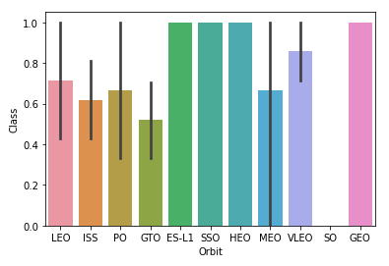
Success Rate vs. Orbit Type
The orbits ES-L1, SSO, HEO, VLEO, and GEO have success rates of more than 80%.
LEO, ISS, PO, GTO, and MEO orbits have success rates between 50% -80%.
Without successful launches, orbit cannot exist.

Slide 21
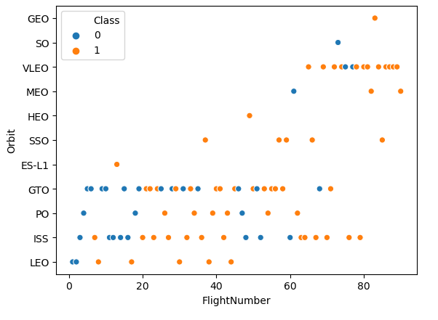
Flight Number vs. Orbit Type
The majority of launches, including the initial ones, were in low orbit up to the GTO, where the likelihood of success rose as the number of launches rise.
The majority of the orbital VLEO testing were productive.

Slide 22
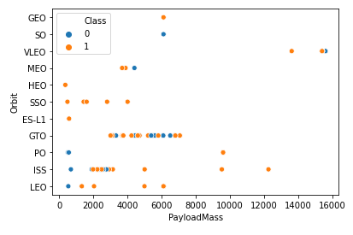
Payload vs. Orbit Type
Apparently, payload and orbit have no underlying relationship.
Low payloads and low orbits indicate a low success rate, but this could also have been the result of the early launch attempts.
The most launches occurred in the orbits GTO and ISS, and ISS also included the most diverse array of payloads.

Slide 23
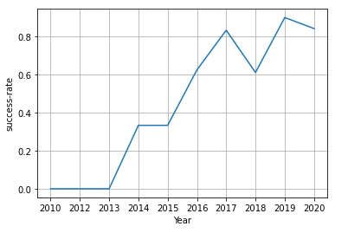
Launch Success Yearly Trend
There were no successful launch attempts between 2010 and 2013.
The likelihood of success increased dramatically in the years that followed.
The most likely year to succeed (more than 90%) was 2019.

Slide 24
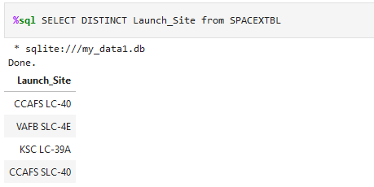
All Launch Site Names
Find the names of the unique launch sites
Query with the keyword "DISTINCT" returns all unique launch sites.

Slide 25
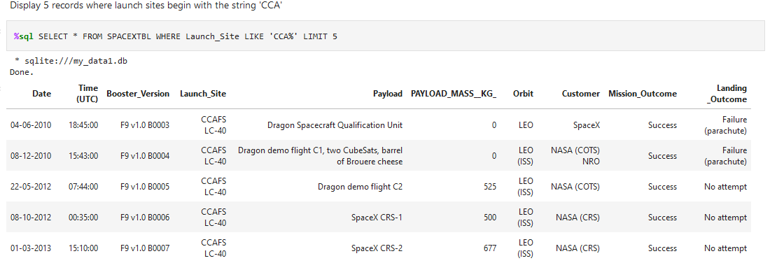
Launch Site Names Begin with 'CCA'
Find 5 records where launch sites begin with `CCA`
The query result shows a selection of 5 entries in the “launch_site" column which start with "CCA“.

Slide 26
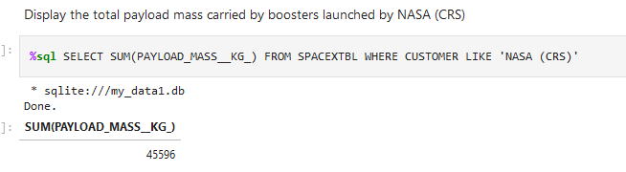
Total Payload Mass
Calculate the total payload carried by boosters from NASA
The result returns the total payload of all boosters launched by NASA.

Slide 27
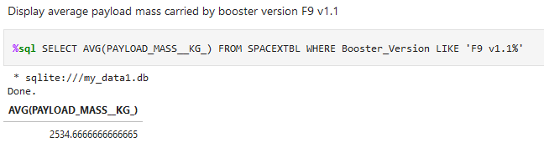
Average Payload Mass by F9 v1.1
Calculate the average payload mass carried by booster version F9 v1.1
Results gives the average payload of the launches with the booster version "F9 v1.1"

Slide 28
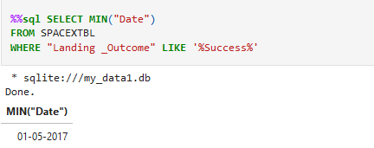
First Successful Ground Landing Date
Find the dates of the first successful landing outcome on ground pad
Query returned the first successful landing on 01/05/2017

Slide 29
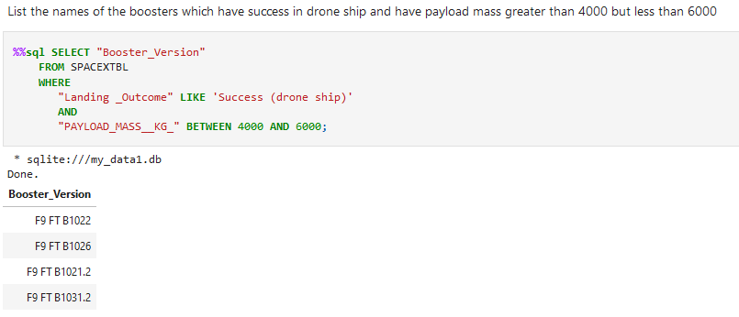
Successful Drone Ship Landing with Payload between 4000 and 6000
Result lists the names of boosters which have successfully landed on drone ship and had payload mass greater than 4000 but less than 6000

Slide 30
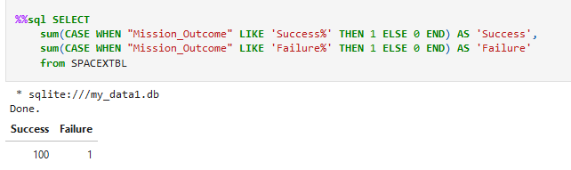
Total Number of Successful and Failure Mission Outcomes
Calculate the total number of successful and failure mission outcomes
Results display the total number of successful and failed mission outcomes. It states that the failed are minimal.

Slide 31
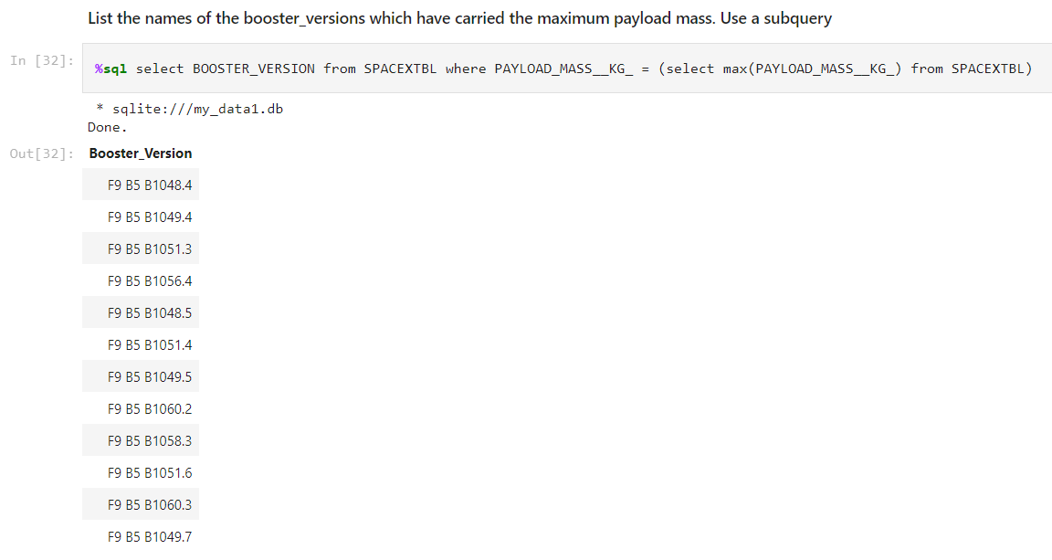
Boosters Carried Maximum Payload
List the names of the booster which have carried the maximum payload mass
Query returns the names of the booster versions that carried the maximum payload, a total of 12 booster versions

Slide 32
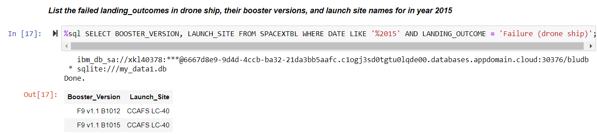
2015 Launch Records
List the failed landing_outcomes in drone ship, their booster versions, and launch site names for in year 2015
For all launches in 2015 that resulted in a failed landing in a drone ship, the combined query gives the names of the booster versions, the launch location, and the landing outcome.

Slide 33
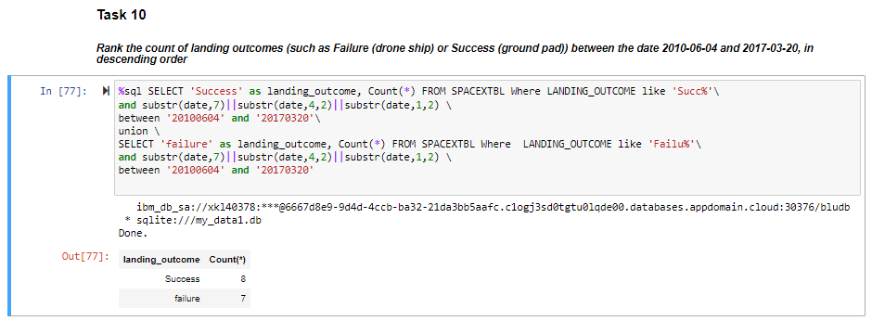
Rank Landing Outcomes Between 2010-06-04 and 2017-03-20
Rank the count of landing outcomes (such as Failure (drone ship) or Success (ground pad)) between the date 2010-06-04 and 2017-03-20, in descending order
There are 8 successful mission and 7 failed mission for the specified duration.

Slide 34

Section 3

Slide 35
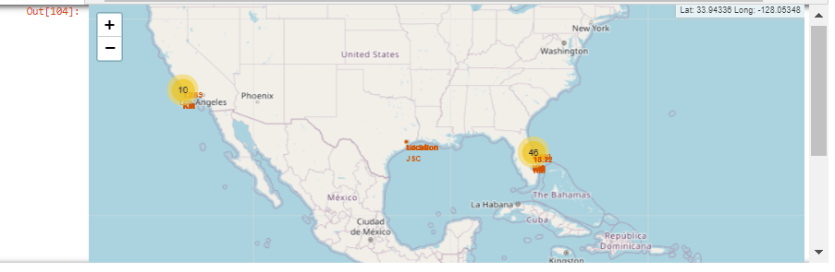
Interactive launch sites Map with Folium
Explore the generated folium map and make a proper screenshot to include all launch sites’ location markers on a global map
There a 3 launch sites across North America located in 3 different states.
California, Texas and Florida. Among the 3 launch sites, Florida Launch site has more launches compared to California & Texas.

Slide 36
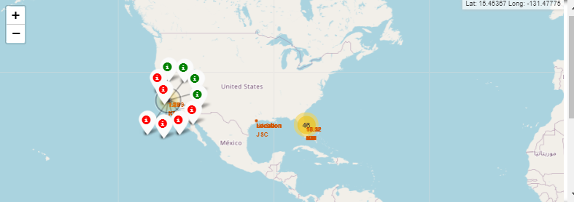
Color-labeled launch outcomes with Folium
Explore the folium map and make a proper screenshot to show the color-labeled launch outcomes on the map
California Launch site has 4 successful launches and 6 failed launches.

Slide 37
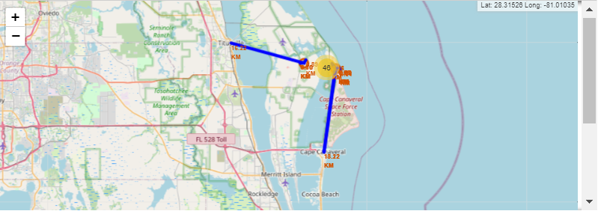
Launch site to its proximities with Folium
Proximity for one of Florida Launch site is 0.9 km from coastline

Slide 38

Section 4

Slide 39
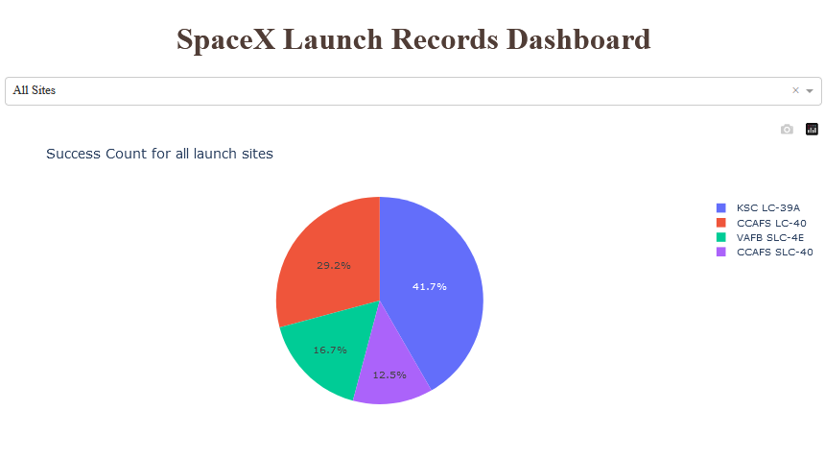
Start success overview for all start sites
Show the screenshot of launch success count for all sites, in a pie-chart
The graphic shows that most successful launch attempts took place at the launch site "KSC LC-39A". In total, more than 2/3 of the total successful missions ran at the two launch sites "KSC LC-39A" and "CCAFS LC-40".

Slide 40
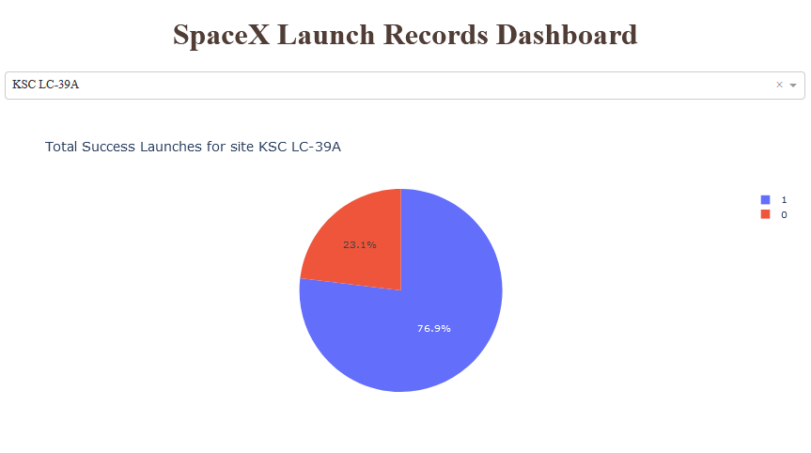
Total Success launches for Site KSC LC-39A
76.9% of the missions carried out at the "KSC LC-39A" launch site were successful, while 23.1% were unsuccessful.

Slide 41
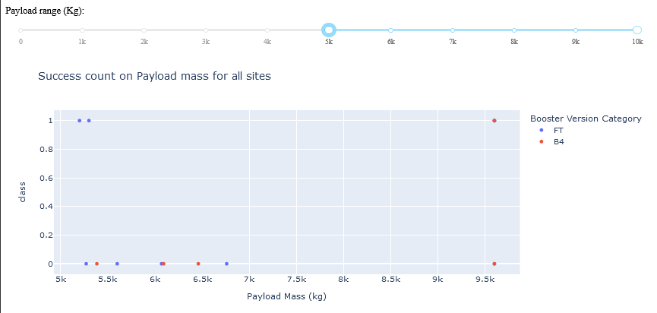
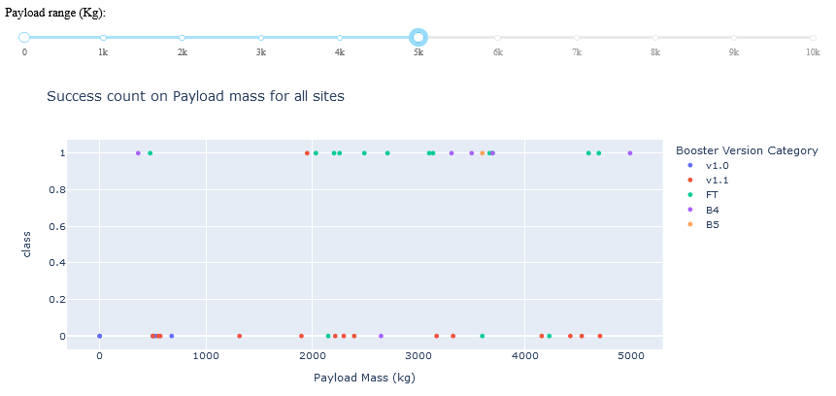
Launch success at different payload masses
Higher range of payload mass
Show screenshots of Payload vs. Launch Outcome scatter plot for all sites, with different payload selected in the range slider
Explain the important elements and findings on the screenshot, such as which payload range or booster version have the largest success rate, etc.
Lower range of payload mass

Slide 42

Section 5

Slide 43
Classification Accuracy
Visualize the built model accuracy for all built classification models, in a bar chart
Decision Tress has the highest classification accuracy

Slide 44

Confusion Matrix
Show the confusion matrix of the best performing model with an explanation
12 True positives
Zero True Negatives
False positives & false negatives are 3

Slide 45
Conclusions
It is observed that Decision tree has the highest classification accuracy with accuracy score of 88.8%.
There are total of 99 launches in the data set provided
Florida launch site has more launches and successful launches compared to the other two launch sites.
Total payload mass of 45,596 Kg’s carried by boosters launched by NASA.
2010 to 2013 saw lower success rates (perhaps because they were also used to adjust and gain experience), but from 2013 to 2020, success rates steadily increased.

Slide 46
Appendix
Github url for Capstone Project:
https://github.com/vangalasandeep/IBMCapstone

Slide 47


